Slide 1


Project Blogging Website: Full-Stack Development with HTML, CSS, and JavaScript
This project involved developing a full-stack blogging website using HTML, CSS, and JavaScript. The website features a user-friendly interface for creating, publishing, and managing blog posts.
by Aditi Singh

Slide 2

Introduction: Understanding the Project Scope
1
Project Goals
2
Target Audience
3
Key Features
The main goal was to create a functional and visually appealing blogging platform.
The website is designed for both bloggers and readers, offering a seamless experience for both.
The website includes essential features such as post creation, editing, and commenting.

Slide 3
Web Design: Crafting an Engaging User Experience
User Interface (UI)
User Experience (UX)
Responsive Design
A visually appealing and intuitive UI is crucial for attracting and retaining users.
Focus on user-centered design to ensure a smooth and enjoyable browsing experience.
The website should adapt to different screen sizes, ensuring optimal viewing on desktops, tablets, and mobile devices.

Slide 4
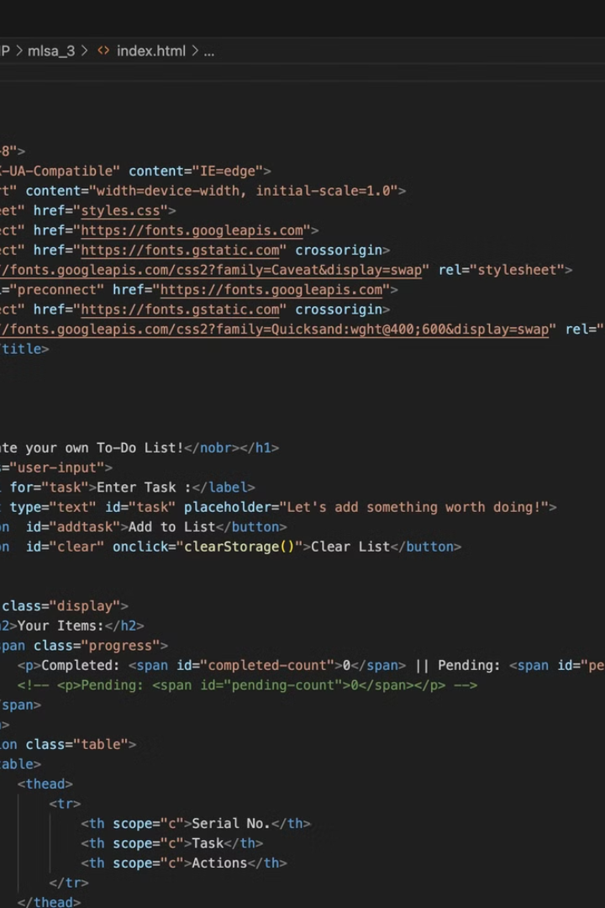



Front-End Development: Bringing the Design to Life
HTML Structure
Build the foundation of the website using HTML elements to define the content and structure of each page.
CSS Styling
Apply styles to the HTML elements using CSS to create the desired look and feel of the website.
JavaScript Functionality
Implement dynamic features using JavaScript to enhance user interaction and improve the overall website experience.

Slide 5

Back-End Integration: Powering the Blogging Functionality
1
Server-Side Logic
Develop server-side code using a language like Python or Node.js to handle data processing, user authentication, and other backend tasks.
2
API Integration
Create or use existing APIs to interact with the database, handle user requests, and deliver dynamic content.
3
Security Measures
Implement security measures such as data encryption and user authentication to protect sensitive information.

Slide 6
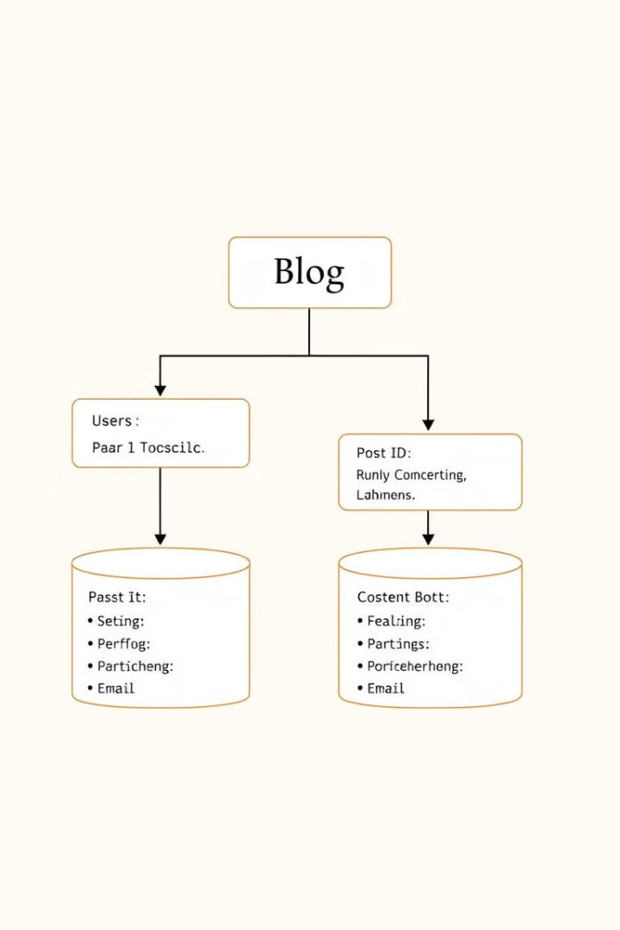
Database Management: Storing and Retrieving Blog Posts
Data Storage
Choose a suitable database system like MySQL or MongoDB to store the website data efficiently.
Data Modeling
Design a database schema to organize the blog posts, user information, and other relevant data.
Data Retrieval
Implement queries to retrieve data from the database and display it dynamically on the website.

Slide 7

Deployment and Hosting: Making the Website Live
Choosing a Hosting Provider
Deploying the Website
Upload the website files to the hosting server and configure the necessary settings for the website to function correctly.
Select a reliable hosting provider that offers suitable features and resources for the website.
Domain Name Registration
Register a domain name for the website to make it accessible online through a unique web address.

Slide 8




Challenges and Lessons Learned
Debugging and Troubleshooting
Time Management
Teamwork and Communication
Encountering and resolving technical issues is a common part of the development process.
Balancing deadlines, project scope, and feature implementation is essential.
Effective collaboration and clear communication are crucial for successful project completion.

Slide 9
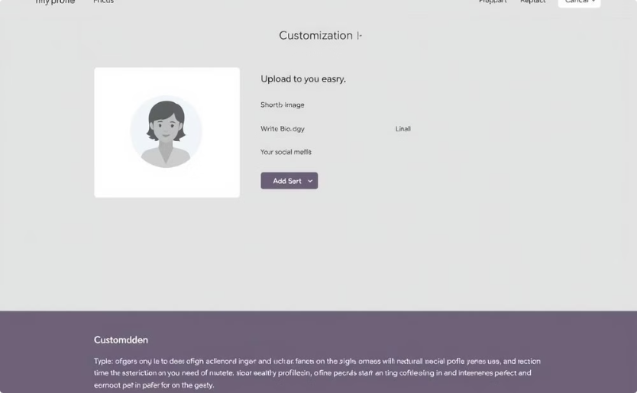
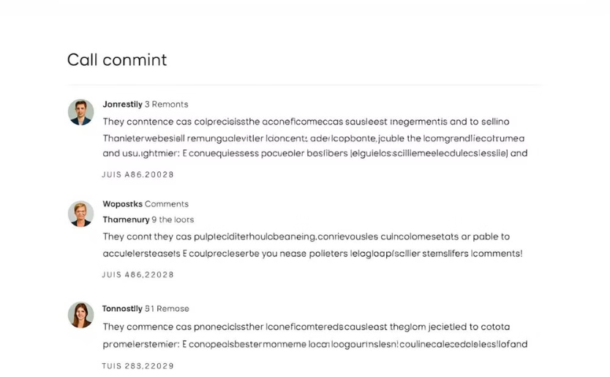
Conclusion: Next Steps and Future Enhancements
User Profile Enhancements
Enhanced Commenting System
Implement more personalized user profiles, allowing users to customize their experience.
Develop a more interactive commenting system to foster community engagement.

